Slide 1

AI-POWERED MONITORING AND PREDICTION OF AIR QUALITY

Slide 2

Learning Objectives
1.Understand air quality parameters
2.Explore Internet of Things & Sensor data collection
3.Apply AI/ML algorithms for prediction
4.Develop and monitoring system
5.Forcast air quality index
6.Enhance problem solving skills
7.Raise environmental awareness
GOAL

Slide 3
Tools and Technology used
1.Programming Languages - Python
2.Machine learning & AI Frameworks - Scikit-learn,Tensorflow
3.Data Visualization – Matplotlib,Seaborn
4.Development and testing - Jupyter Notebook
5.Version Control - Github project storage

Slide 4
Methodology
1.Problem Identification
2.Data Collection
3.Data preprocessing
4.Model development
5.Model Evaluation
6.Visualization & Monitoring
7.Result & conclusion

Slide 5
Problem Statement:
Air pollution has become a major global concern, causing serious health risks and environmental damage. Traditional monitoring systems are expensive, limited in coverage, and often fail to provide predictive insights. Without accurate forecasts, individuals and policymakers cannot take timely preventive measures against hazardous pollution levels. Therefore, there is a need for an AI-powered system that can analyze air quality data, predict AQI, and provide continuous monitoring to raise awareness and support better decision-making.

Slide 6
Solution:
To overcome these challenges, an AI-powered software system is proposed that analyzes historical air quality datasets and predicts the Air Quality Index (AQI) using machine learning algorithms. The system preprocesses and trains data to provide accurate forecasts of pollution levels. It also visualizes real-time trends through graphs and dashboards, enabling continuous monitoring. This solution helps create awareness, supports timely decision-making, and contributes toward building healthier and smarter cities.

Slide 7
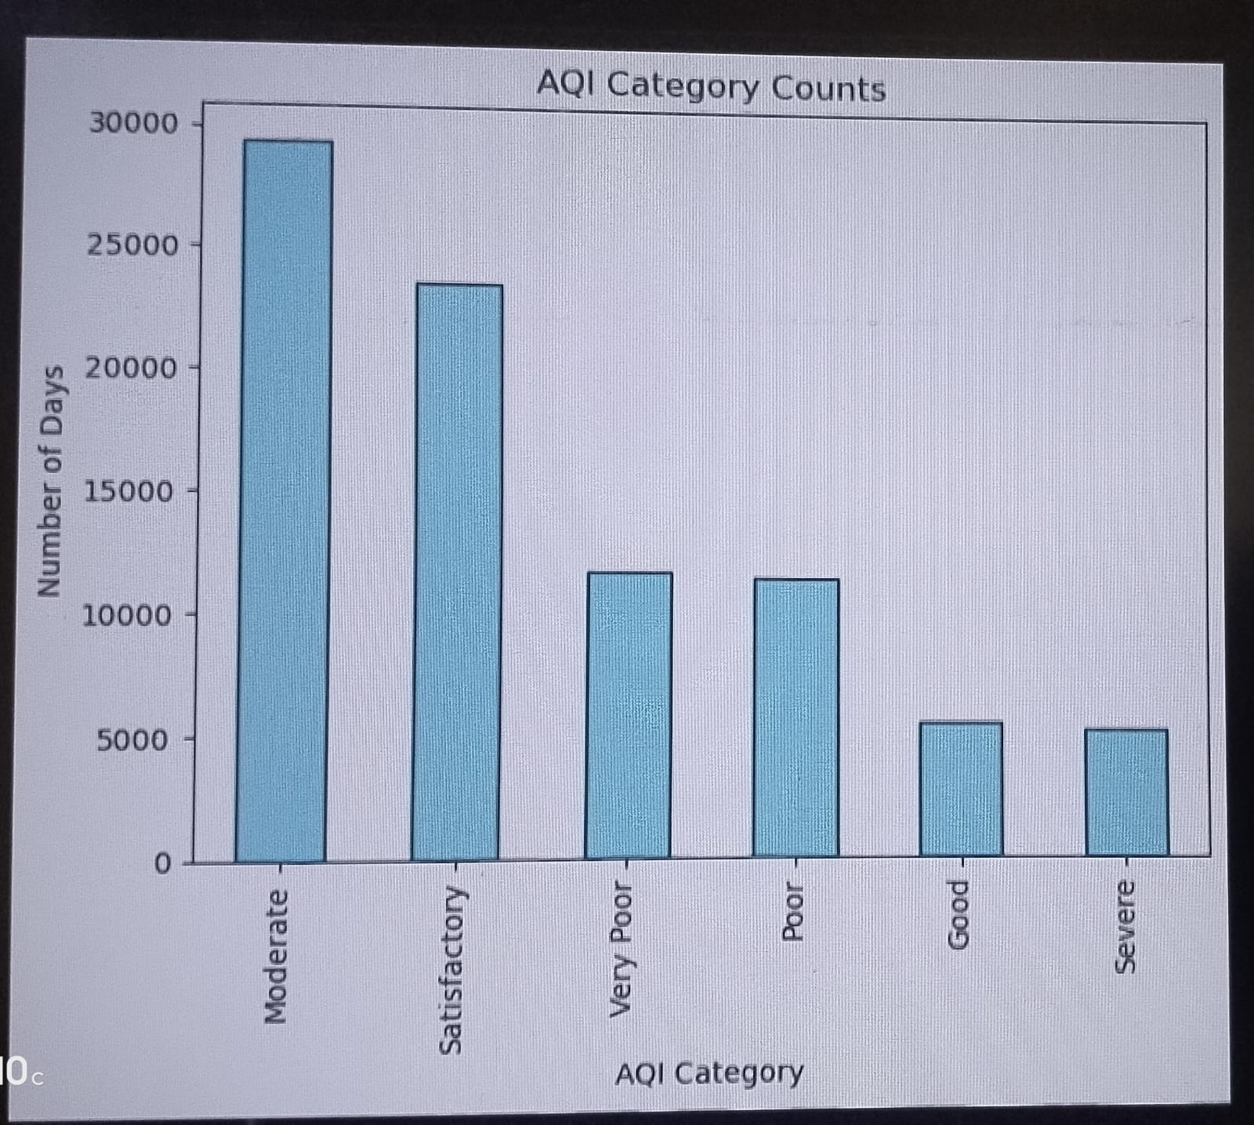
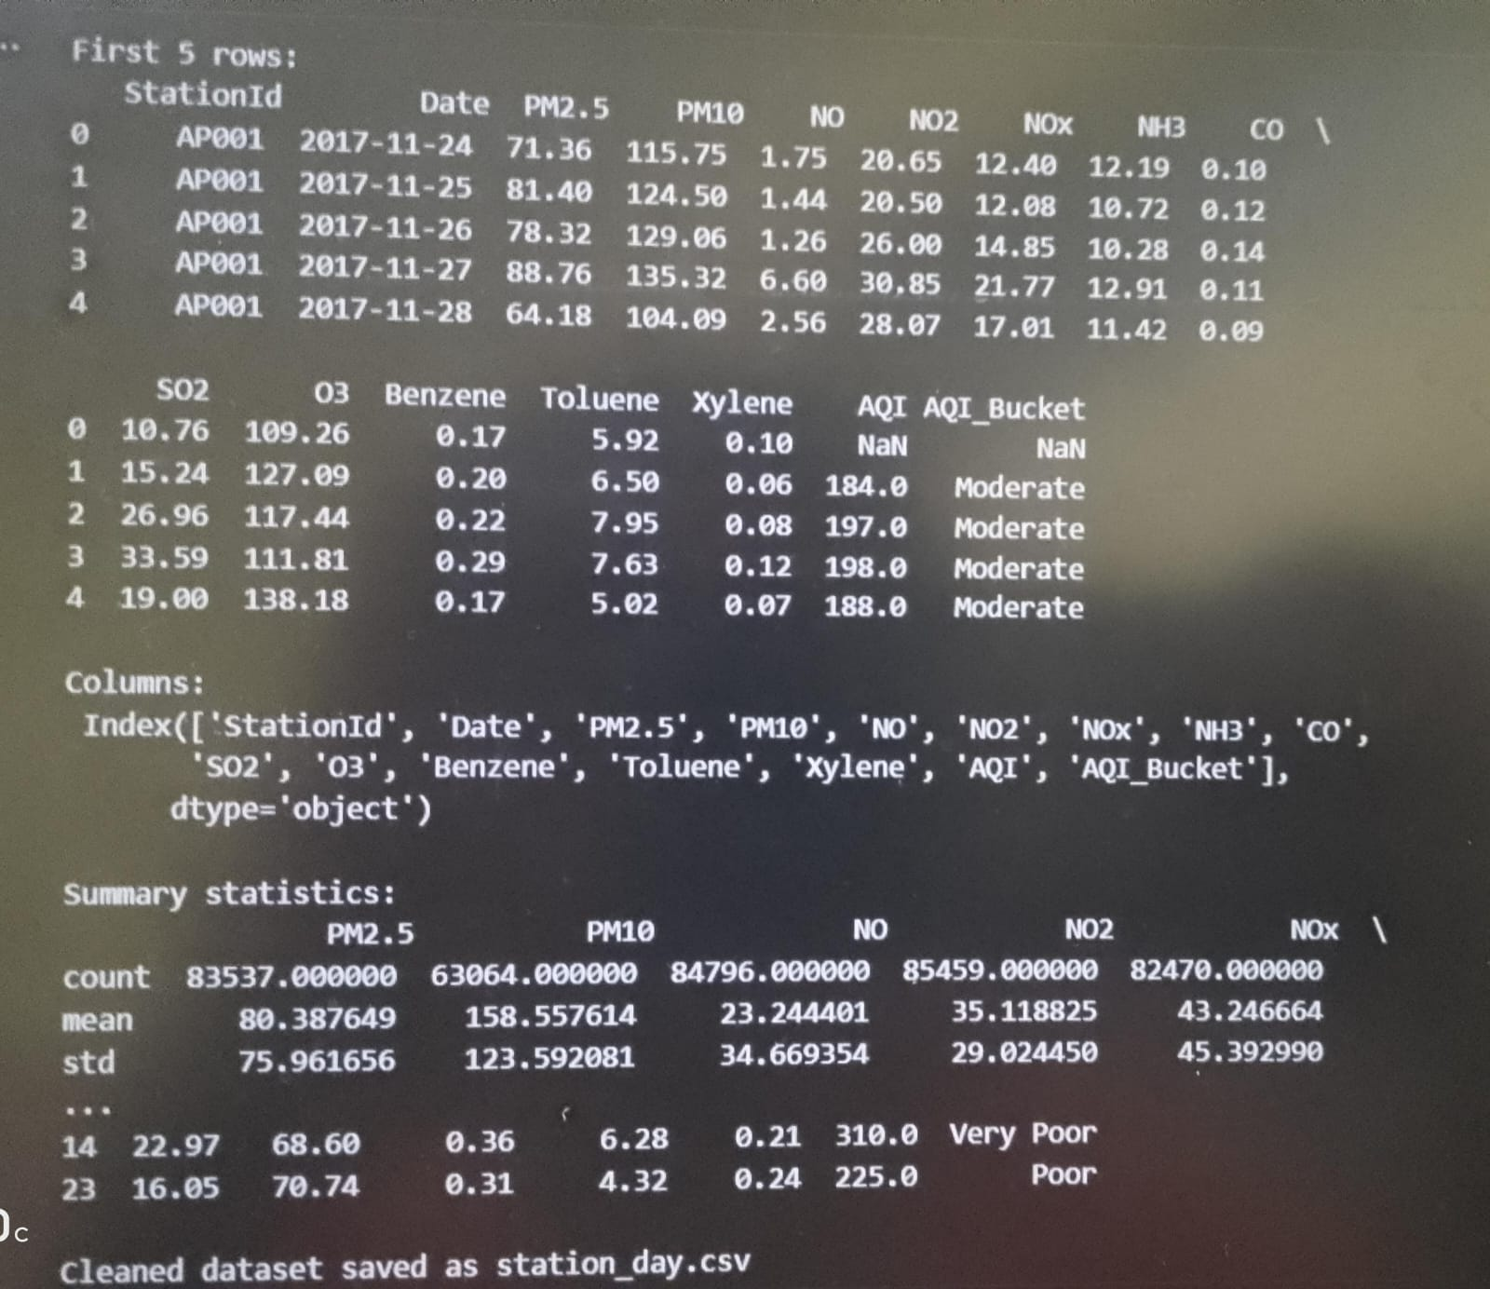
Screenshot of Output:
Data cleaning AQI counts

Slide 8
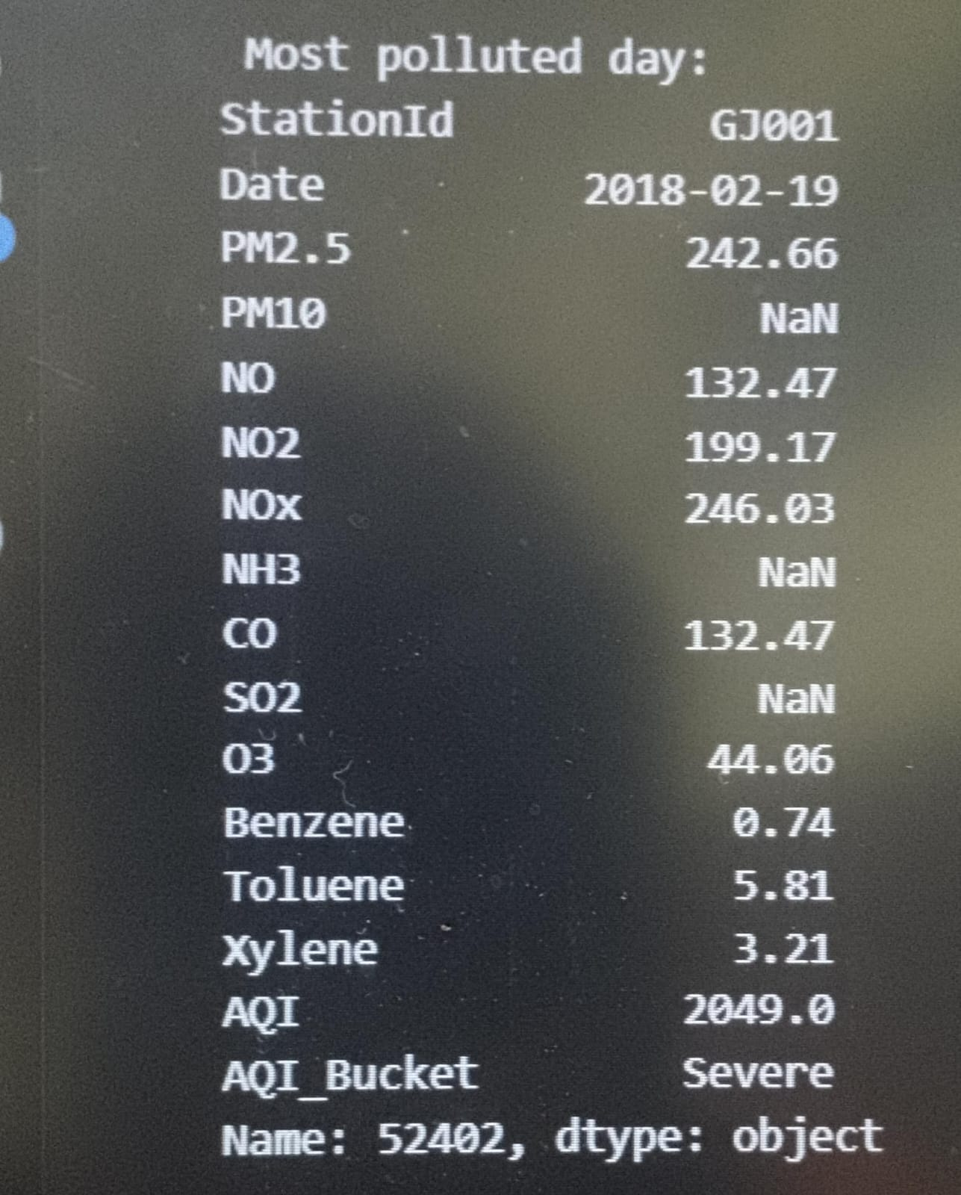
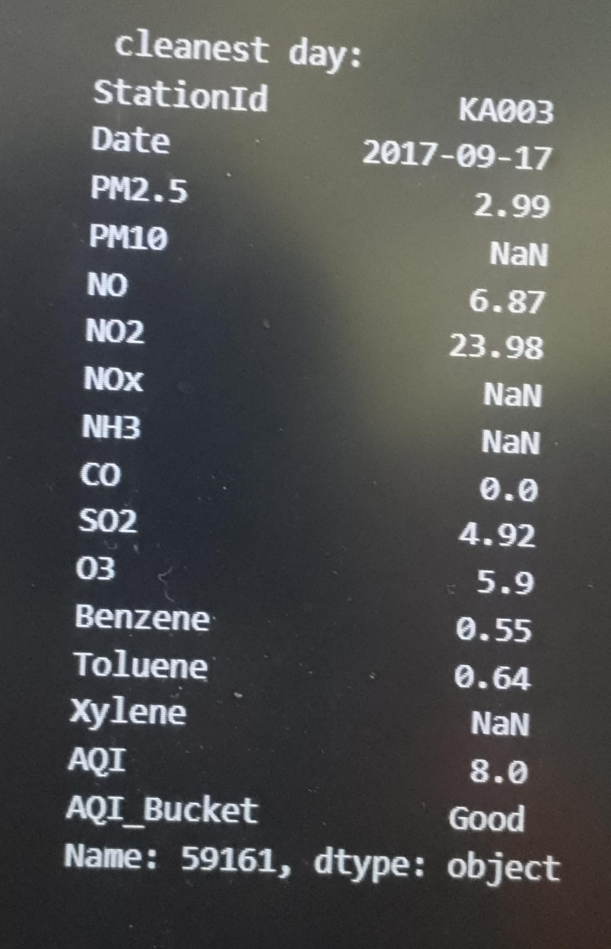
Most polluted day Most cleanest day

Slide 9
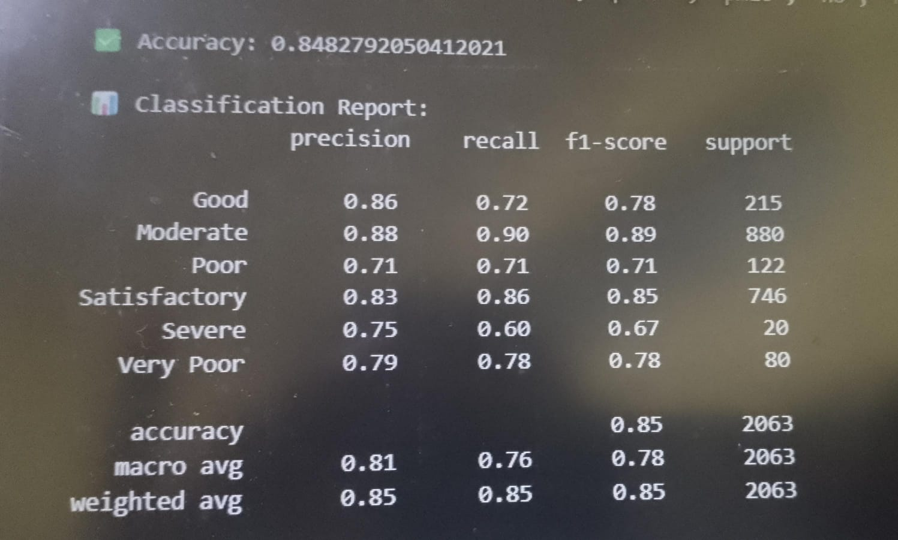
Accuracy of the model= 84%

Slide 10
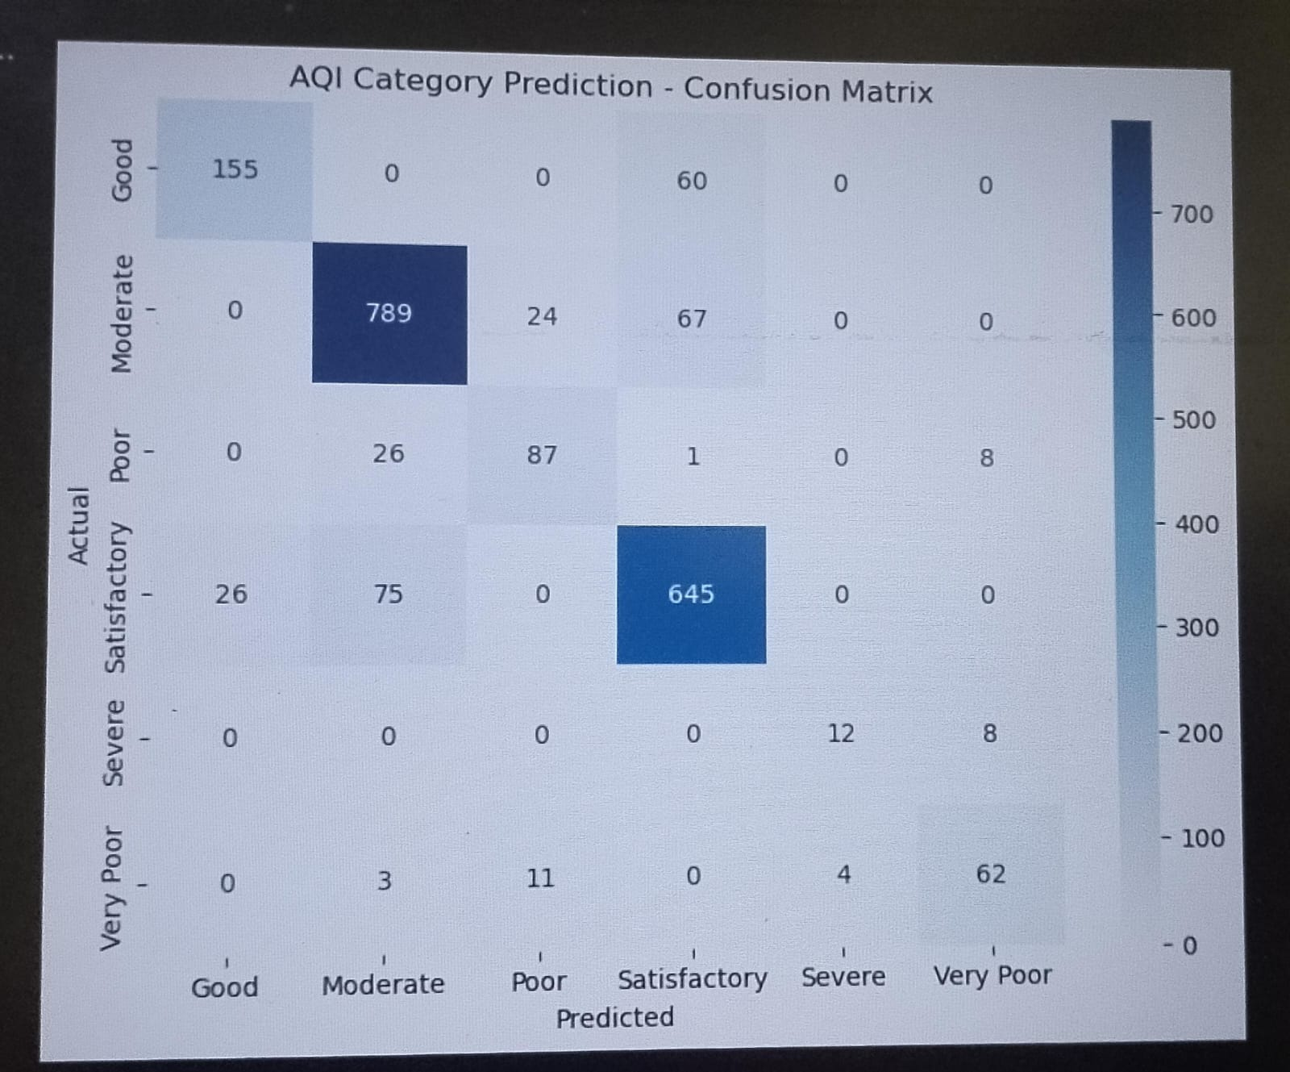
Confusion matrix of the model

Slide 11
Conclusion:
The AI-powered prediction and air quality monitoring system effectively forecasts AQI using machine learning techniques. It provides real-time insights and visualizations that support awareness and preventive actions. This project demonstrates how AI can contribute to environmental sustainability and healthier living.

